Slide 1
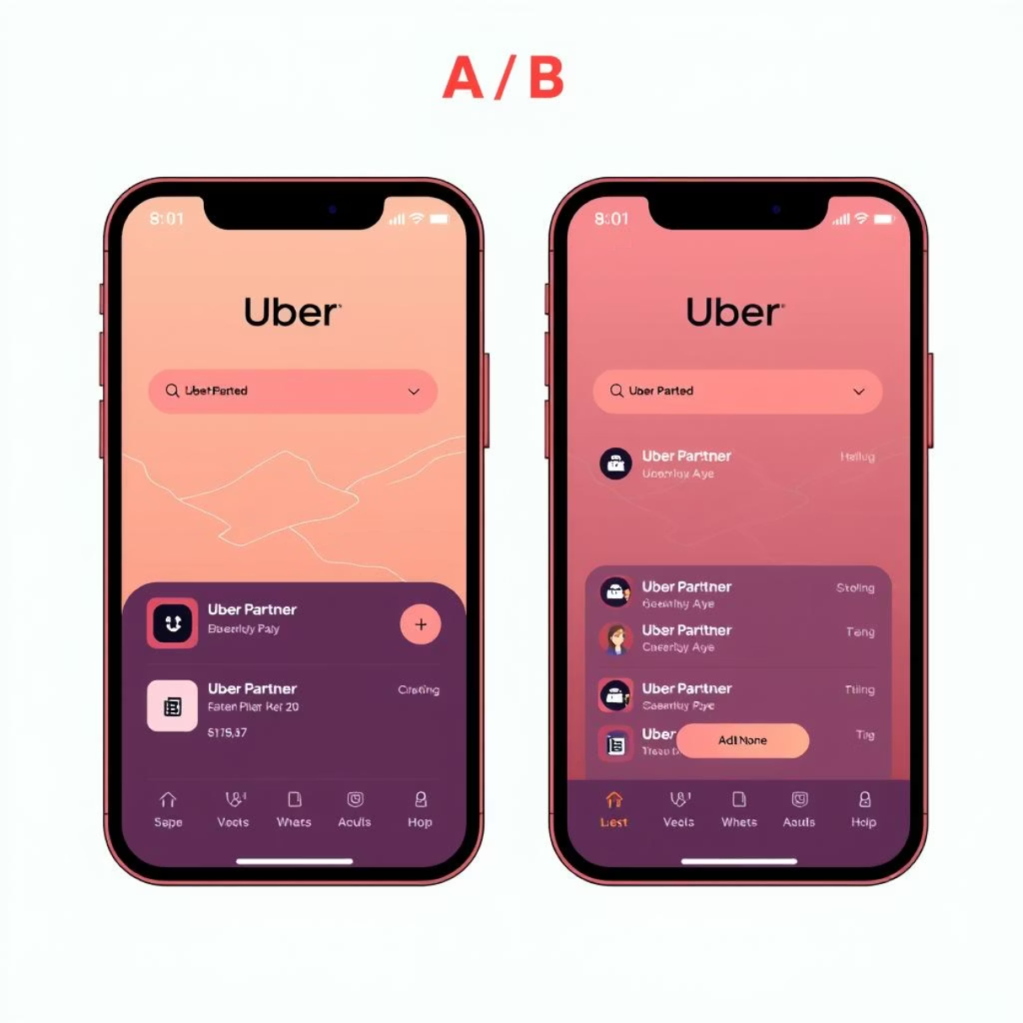
A Data-Driven Analysis of the Uber Partner App: A/B Testing
by Saubhagya Monal

Slide 2
Objective: Assessing the Redesigned App
Uber has launched a redesigned partner app aimed at expanding its utility beyond a simple driving tool. The new version integrates enhanced features such as detailed earnings information, driver ratings, and a unified communication platform.
The primary goal of this analysis is to evaluate the effectiveness of the redesigned app in converting new sign-ups into active drivers. This is achieved through a controlled A/B test.

Slide 3
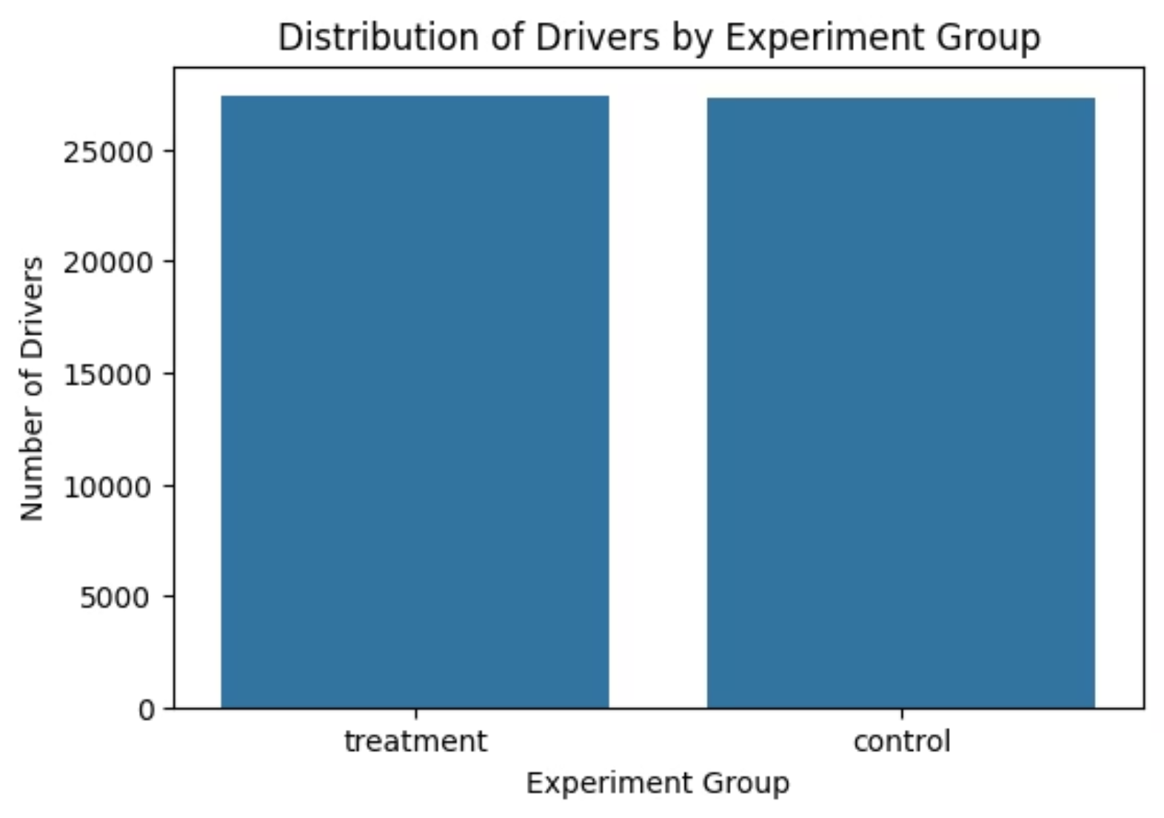
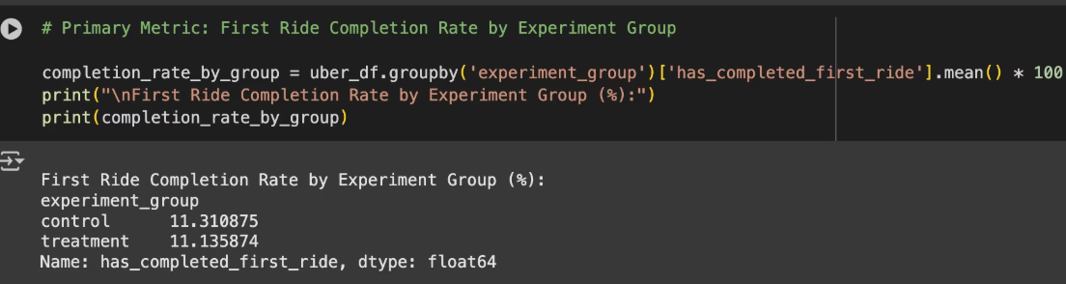
A/B Test Methodology and Performance Indicators
1. Experiment Structure: A randomized A/B test was implemented to ensure a rigorous comparison.
Control Group (50%): Utilized the original app version.
Treatment Group (50%): Was exposed to the redesigned app.
2. Primary Success Metric: First Ride Completion Rate
Definition: The percentage of new sign-ups who successfully complete their first paid ride.
Justification: This metric serves as the most direct and crucial indicator of a successful driver activation. It is a foundational step for all future driver value and serves as a strong predictor of long-term engagement.
3. Secondary Metrics: To provide a comprehensive view, the following secondary metrics were also considered:
Time to First Ride Completion: Evaluates the efficiency of the onboarding process.
Driver Conversion Rate at Key Onboarding Stages: Identifies potential bottlenecks within the signup funnel.

Slide 4
About Uber
The Company: Uber
Uber is a global technology company best known for its ride-hailing app, which connects riders with drivers. The company's business model is centered on a platform that facilitates transportation and, more recently, food delivery (Uber Eats) and other services.
The Uber Partner App
The Uber Partner app is a crucial component of this business model. It is the primary tool used by drivers to:
Sign Up and Onboard: The initial process for new drivers to register, complete background checks, and add their vehicle information.
Find and Accept Rides: The core functionality for drivers to find, accept, and complete trip requests.
Manage Earnings and Logistics: A platform for drivers to track their income, manage their schedule, and receive support.

Slide 5
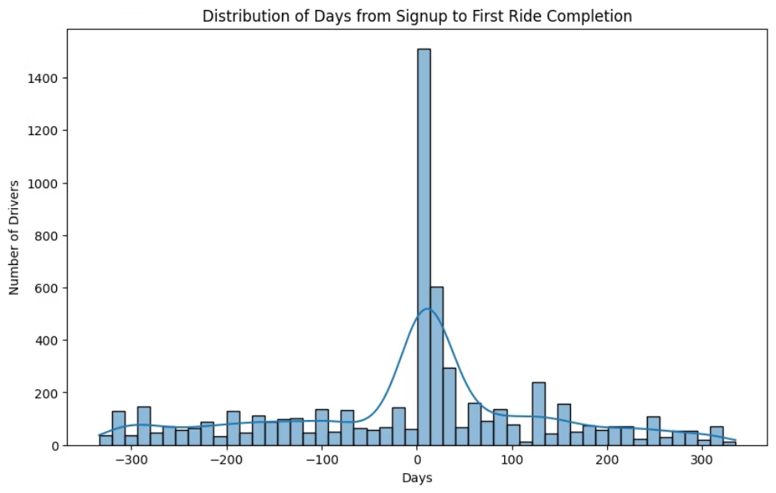
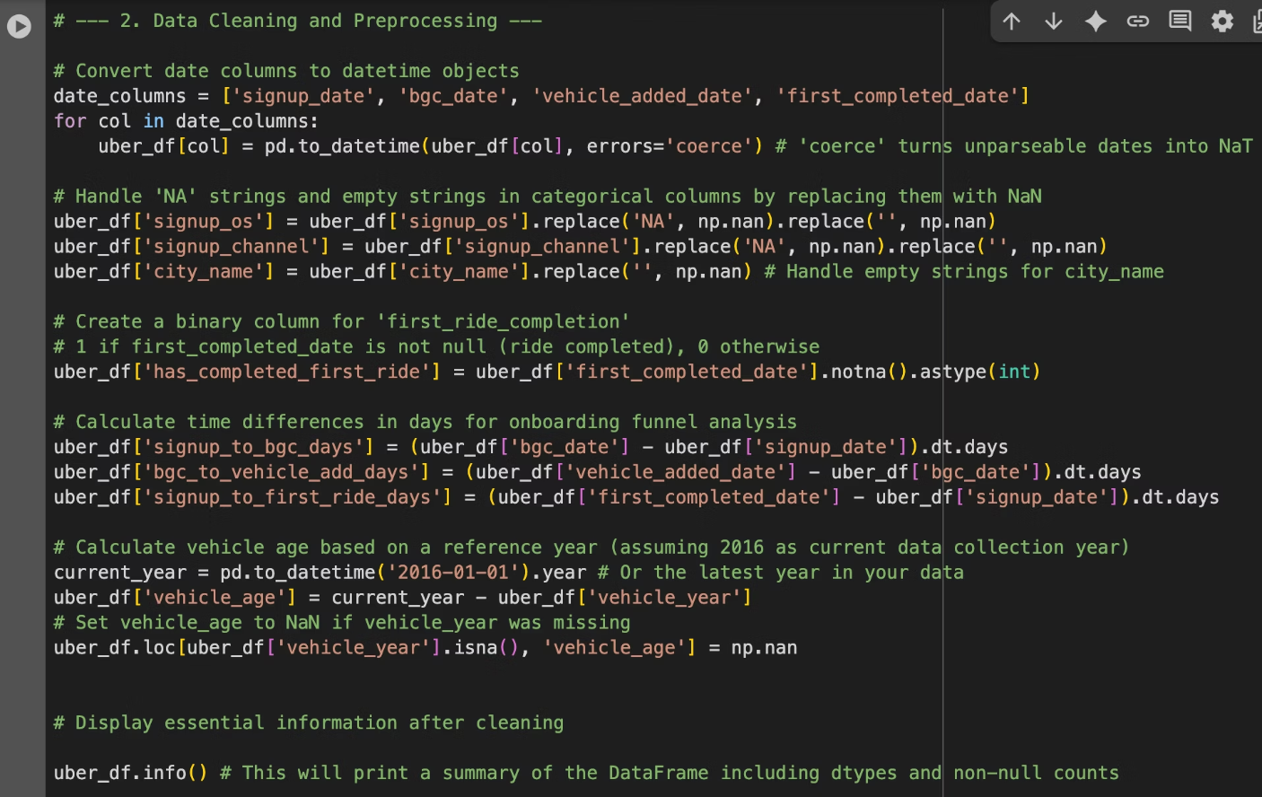
Data Cleaning and Exploratory Insights
Data Source: The analysis utilized the provided Uber A_B testing dataset.
Preparation Process: Data was meticulously prepared for analysis through several key steps:
Date columns were converted to a consistent datetime format.
Inconsistent missing values (e.g., 'NA', empty strings) were standardized.
A binary feature, has_completed_first_ride, was engineered to support the primary metric analysis.
Exploratory Findings:
The control and treatment groups exhibited a balanced distribution.
Initial descriptive statistics provided an overview of driver activity across different cities and channels.

Slide 6
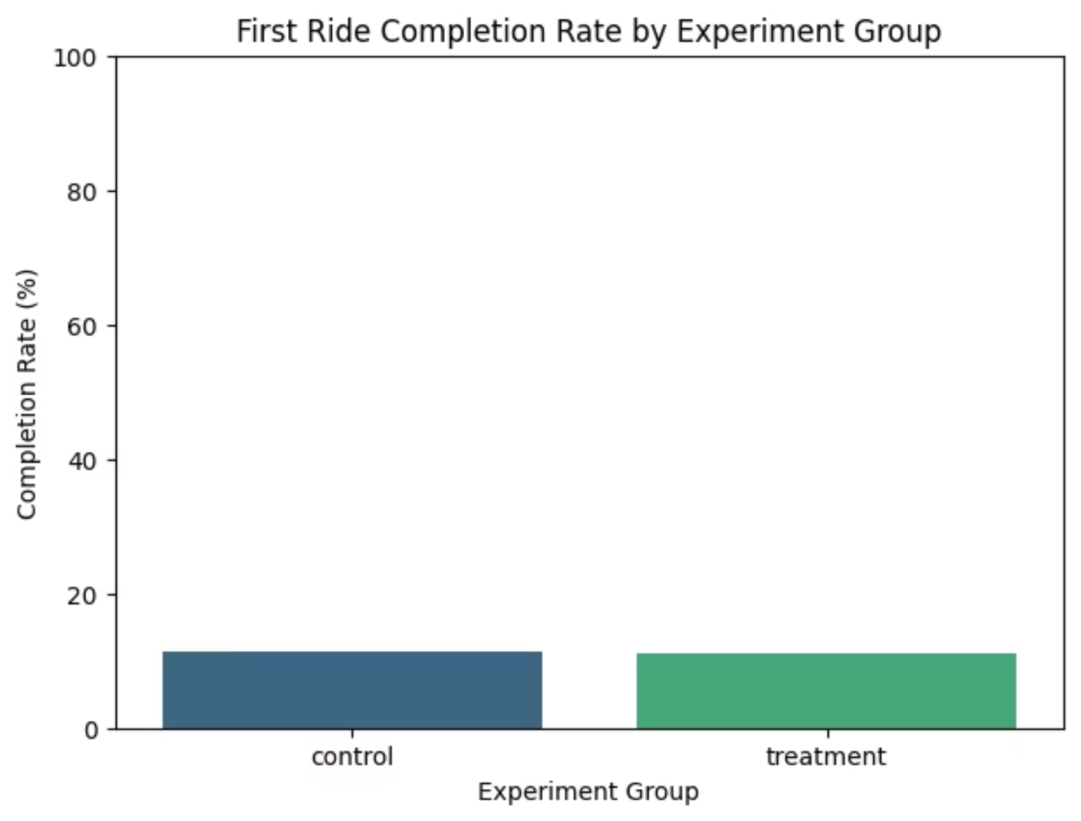
A/B Test Results: Primary Metric Performance
Performance Data:
Control Group: 11.310875 %
Treatment Group: 11.135874 %
Statistical Significance:
A proportion test resulted in a p-value of 0.5168, which is above the standard 0.05 significance level. This indicates that the observed difference is likely attributable to random variation and not the app redesign.

Slide 7
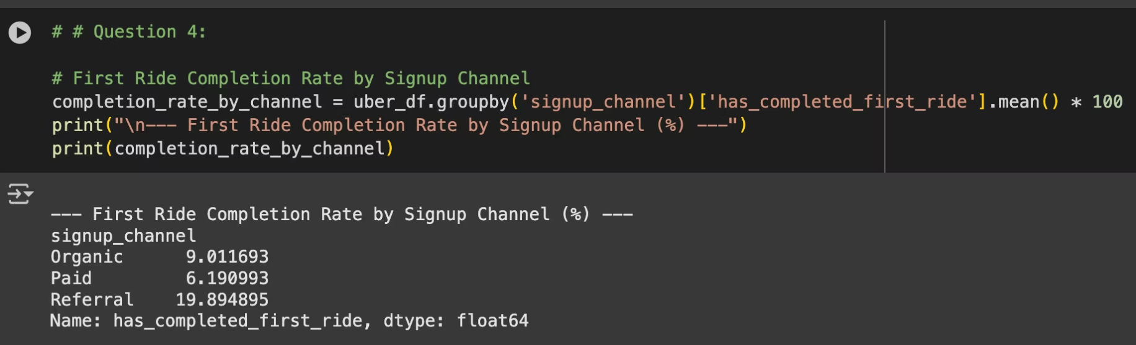
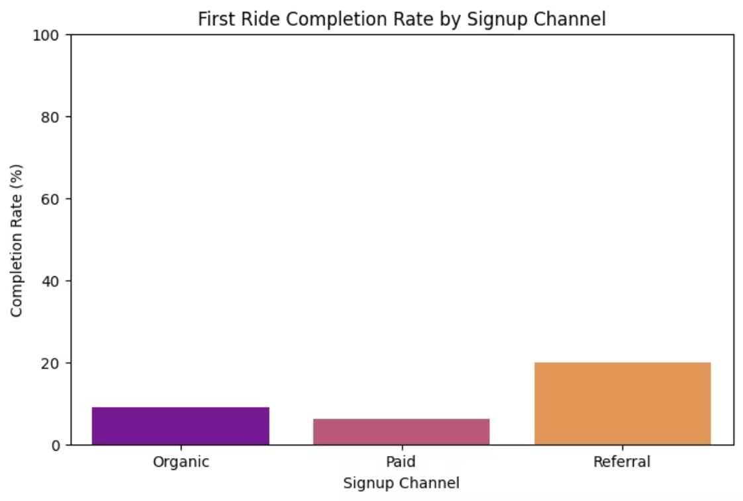
Key Finding: The Impact of Signup Channels
Analysis: A Chi-square test confirmed a statistically significant difference in completion rates across different signup channels (p-value: 0.0000).
Channel Performance:
Referral: Demonstrated the highest completion rate at 19.89%.
Organic: Exhibited a moderate rate at 9.01%.
Paid: Showed the lowest rate at 6.19%.
Strategic Insight: This finding identifies a critical driver for activation. Drivers acquired through the referral channel are demonstrably more likely to complete their first ride, suggesting a pre-existing level of intent or support.

Slide 8
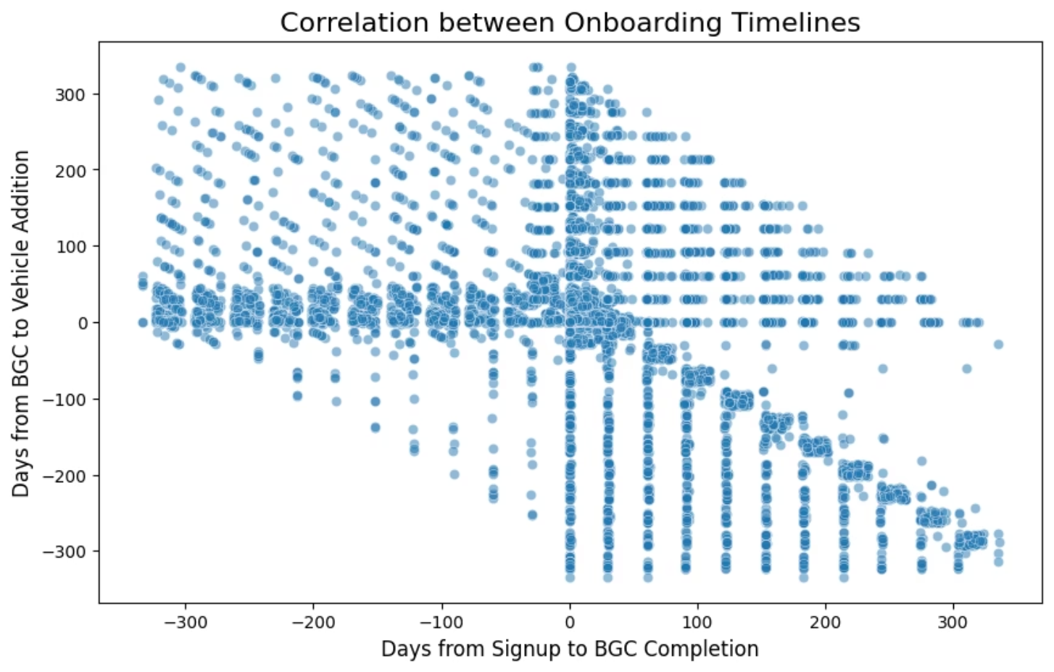
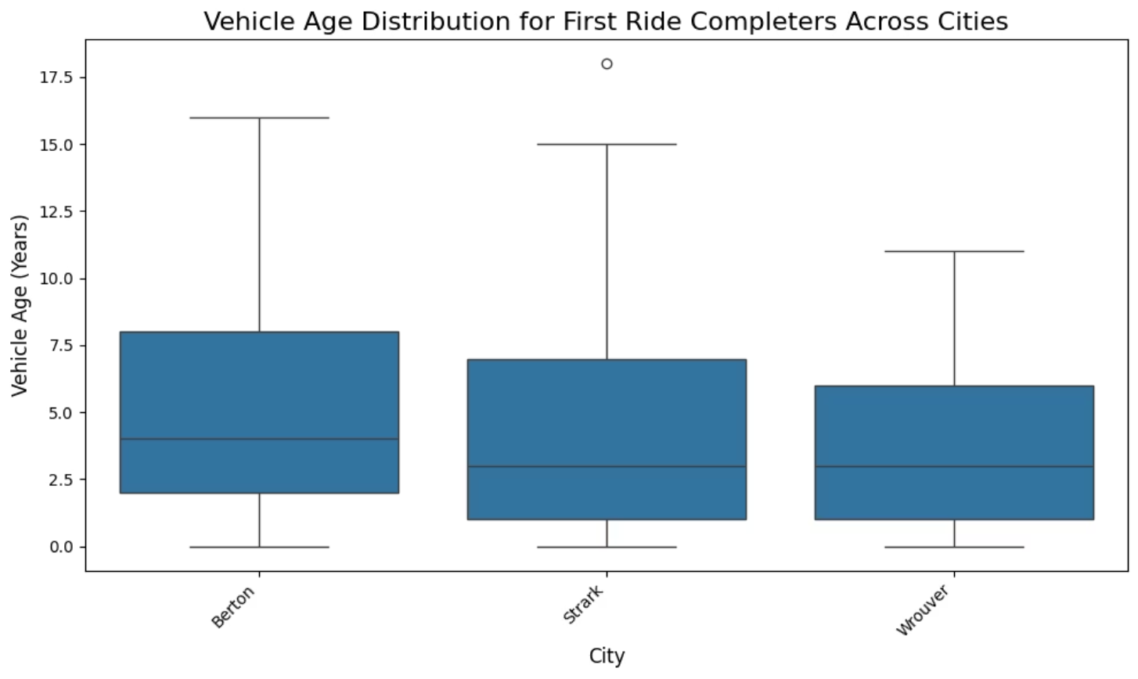
Onboarding Timelines & Vehicle Insights
Onboarding Correlation: A Pearson correlation test revealed a statistically significant negative correlation (r = -0.3565, p-value: 0.0000) between the time from signup to background check and the time from background check to vehicle addition. This indicates that a delay in one stage may be associated with a more rapid progression in the next.
Vehicle Ages: A one-way ANOVA test confirmed a statistically significant variation in mean vehicle ages for first-ride completers across different cities (p-value: 0.0000). This suggests that local market dynamics or regulations influence the vehicle characteristics of the active driver fleet.

Slide 9
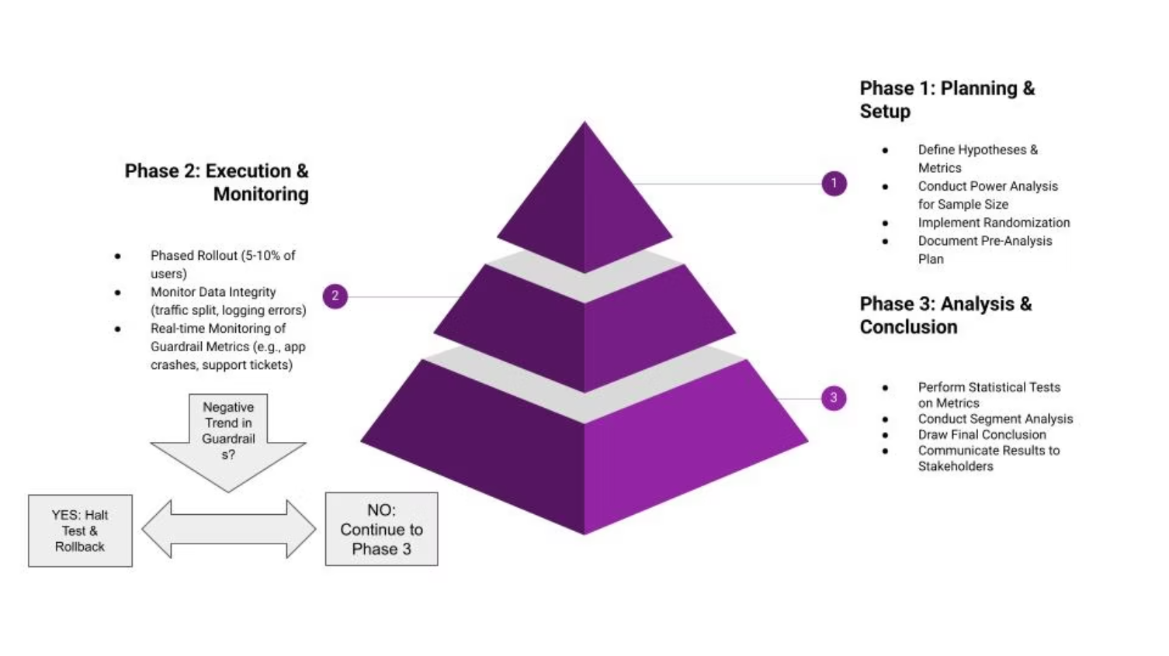
A Framework for Future A/B Tests
The given chart outlines a three-phase plan: planning, execution, and analysis for evaluating future app changes, emphasizing the importance of statistical validity, continuous risk monitoring, and a data-driven final decision.

Slide 10
Data Limitations
Primary Limitation: The provided dataset lacks crucial financial information related to driver earnings.
Impact: This absence prevented the analysis from addressing key questions regarding:
The new app's effect on driver earnings.
The correlation of demographic factors (e.g., city type, vehicle model) with earnings rates.
Recommendation: To enable a complete business impact assessment in future studies, the collection of earnings data is essential.

Slide 11
Final Recommendation and Strategic Actions
Recommendation: Based on the results, a full-scale implementation of the new app design is not recommended at this time. The lack of a statistically significant uplift in the primary success metric does not justify the associated costs and risks.
Suggested Next Steps:
Iterate and Test: Gather qualitative feedback from drivers to refine the new app and consider a new A/B test with a refined version.
Optimize High-Value Channels: Strategically invest in and expand the referral program, given its proven effectiveness in driver activation.
Enhance Future Data Collection: Ensure future experiments track key financial metrics and a wider range of demographic data to enable a more robust analysis.

Slide 12
Conclusion
A/B Test: The new app design did not significantly impact driver activation, with the control group (11.31%) and treatment group (11.14%) showing statistically similar first ride completion rates (p-value = 0.5168).
Recruitment Channels: Driver activation is strongly correlated with the signup channel. The Referral channel was the most effective, with a 19.89% completion rate, significantly higher than Organic (9.01%) and Paid (6.19%) channels (p-value = 0.0000).
Onboarding Efficiency: A statistically significant negative correlation (-0.3565) exists between the time taken for a background check and the time taken to add a vehicle (p-value = 0.0000).
Vehicle Demographics: The average vehicle age for active drivers varies significantly by city. Wrouver has the newest vehicles (mean age of 3.83 years), while Berton has the oldest (mean age of 4.90 years) (p-value = 0.0000).
Strategic Recommendation: Given the lack of a measurable uplift, a full-scale rollout of the new app is not recommended. Instead, focus should be on optimizing the high-performing Referral channel and addressing potential friction points in the onboarding funnel identified by the correlation analysis.

Slide 13

Reference
Data Used: Newton School
Applications Used: Google Colab, MS Word, MS PowerPoint

